Slide 1


A*
AO*
MEAN END ANALYSIS

Slide 2



Unit 3
Finding Optimal Path
A* Algorithm
A* is an informed search algorithm, or a best-first search, meaning that it is formulated in terms of weighted graphs: starting from a specific starting node of a graph, it aims to find a path to the given goal node having the smallest cost
It does this by maintaining a tree of paths originating at the start node and extending those paths one edge at a time until its termination criterion is satisfied.
At each iteration of its main loop, A* needs to determine which of its paths to extend.
It does so based on the cost of the path and an estimate of the cost required to extend the path all the way to the goal.
Specifically, A* selects the path that minimizes f(n) = g(n) + h(n)
where n is the next node on the path, g(n) is the cost of the path from the start node to n, and h(n) is a heuristic function that estimates the cost of the cheapest path from n to the goal.
A* terminates when the path it chooses to extend is a path from start to goal or if there are no paths eligible to be extended.
The heuristic function is problem-specific. If the heuristic function is admissible,
Meaning that it never overestimates the actual cost to get to the goal, A* is guaranteed to return a least-cost path from start to goal.

Slide 3
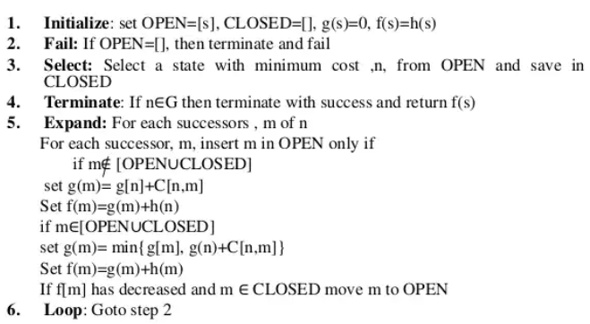
Unit 3
Finding Optimal Path
A* Algorithm

Slide 4
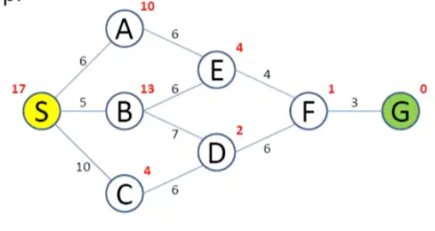
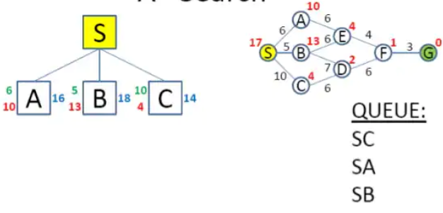
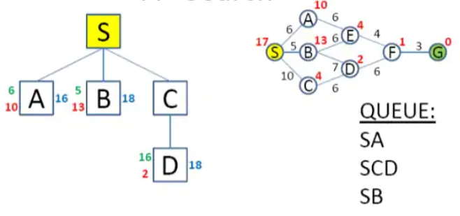
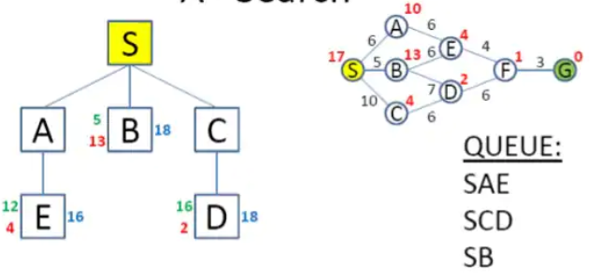
Unit 3
Finding Optimal Path
A* Algorithm

Slide 5
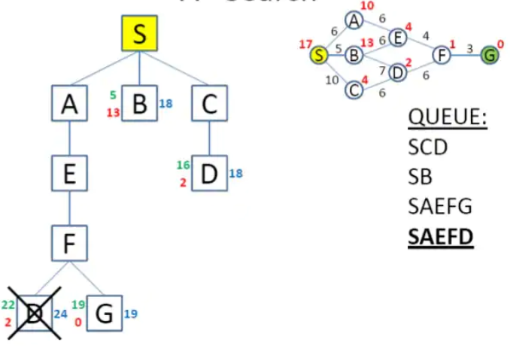
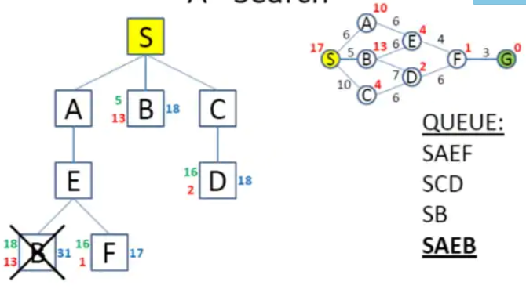
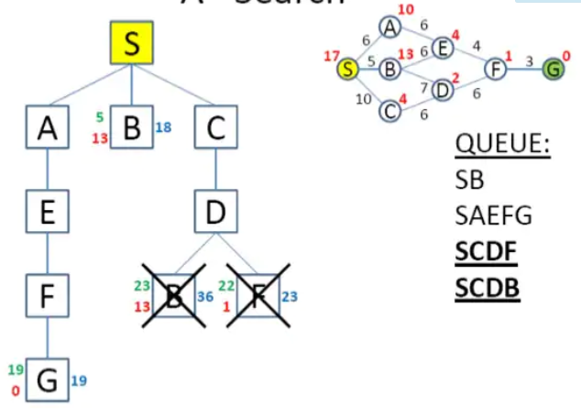
Unit 3
Finding Optimal Path
A* Algorithm

Slide 6
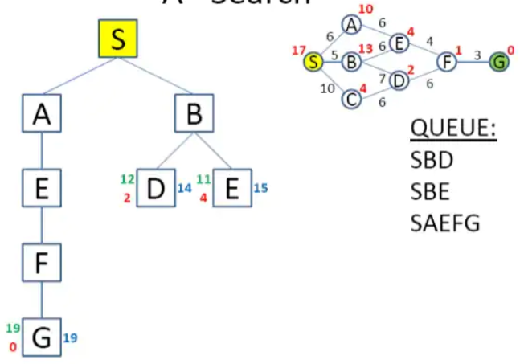
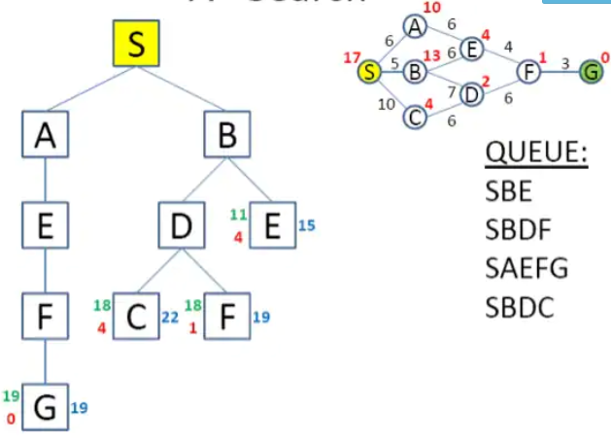
Unit 3
Finding Optimal Path
A* Algorithm

Slide 7
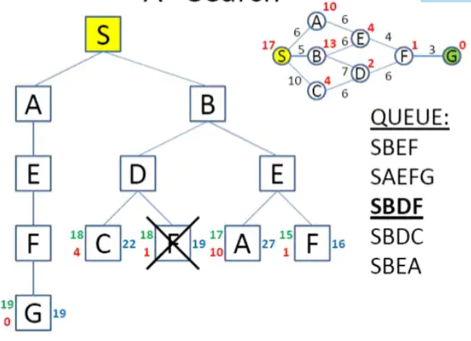
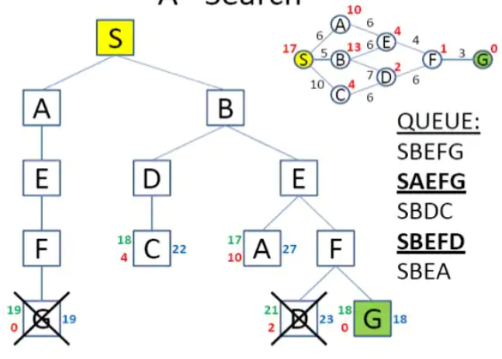
Unit 3
Finding Optimal Path
A* Algorithm

Slide 8
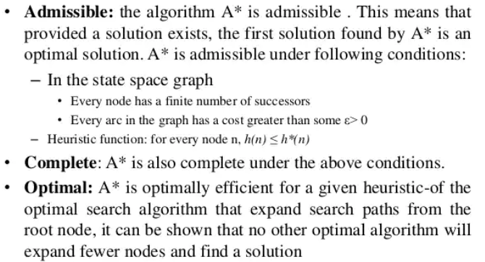
Unit 3
Finding Optimal Path
A* Algorithm

Slide 9

Finding Optimal Path
AO* Algorithm
When a problem can be divided into a set of sub problems, where each sub problem can be solved separately and a combination of these will be a solution, AND-OR graphs or AND - OR trees are used for representing the solution.
The decomposition of the problem or problem reduction generates AND arcs. One AND are may point to any number of successor nodes.
All these must be solved so that the arc will rise to many arcs, indicating several possible solutions.
Hence the graph is known as AND - OR instead of AND. Figure shows an AND - OR graph.

Slide 10
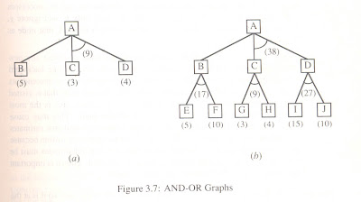
Unit 3
Finding Optimal Path
AO* Algorithm
An algorithm to find a solution in an AND - OR graph must handle AND area appropriately. A* algorithm can not search AND - OR graphs efficiently. This can be understand from the give figure.
In figure (a) the top node A has been expanded producing two area one leading to B and leading to C-D . the numbers at each node represent the value of f ' at that node (cost of getting to the goal state from current state). For simplicity, it is assumed that every operation(i.e. applying a rule) has unit cost, i.e., each are with single successor will have a cost of 1 and each of its components. With the available information till now , it appears that C is the most promising node to expand since its f ' = 3 , the lowest but going through B would be better since to use C we must also use D' and the cost would be 9(3+4+1+1). Through B it would be 6(5+1).

Slide 11
Unit 3
Finding Optimal Path
AO* Algorithm
Let G consists only to the node representing the initial state call this node INTT. Compute h' (INIT).
Until INIT is labeled SOLVED or hi (INIT) becomes greater than FUTILITY, repeat the following procedure.
Trace the marked arcs from INIT and select an unbounded node NODE.
Generate the successors of NODE . if there are no successors then assign FUTILITY as h' (NODE). This means that NODE is not solvable. If there are successors then for each one called SUCCESSOR, that is not also an ancester of NODE do the following
add SUCCESSOR to graph G
if successor is not a terminal node, mark it solved and assign zero to its h ' value.
If successor is not a terminal node, compute it h' value.
propagate the newly discovered information up the graph by doing the following . let S be a set of nodes that have been marked SOLVED. Initialize S to NODE. Until S is empty repeat the following procedure;
select a node from S call if CURRENT and remove it from S.
compute h' of each of the arcs emerging from CURRENT , Assign minimum h' to CURRENT.
Mark the minimum cost path a s the best out of CURRENT.
Mark CURRENT SOLVED if all of the nodes connected to it through the new marked are have been labeled SOLVED.
If CURRENT has been marked SOLVED or its h ' has just changed, its new status must be propagate backwards up the graph . hence all the ancestors of CURRENT are added to S.

Slide 12
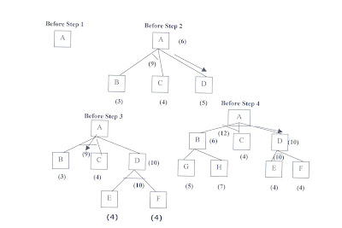
Unit 3
Finding Optimal Path
AO* Algorithm Example

Slide 13
Means and End Analysis
Means end analysis is a technique used to solve problems in AI programs.
This technique combines forward and backward strategies to solve complex problems.
With these mixed strategies, complex problems can be tackled first, followed by smaller ones.
In this technique, the system evaluates the differences between the current state or position and the target or goal state.
It then decides the best action to be undertaken to reach the end goal.

Slide 14
How MEA works
Means end analysis uses the following processes to achieve its objectives:
First, the system evaluates the current state to establish whether there is a problem. If a problem is identified, then it means that an action should be taken to correct it.
The second step involves defining the target or desired goal that needs to be achieved.
The target goal is split into sub-goals, that are further split into other smaller goals.
This step involves establishing the actions or operations that will be carried out to achieve the end state.
In this step, all the sub-goals are linked with corresponding executable actions (operations).
After that is done, intermediate steps are undertaken to solve the problems in the current state. The chosen operators will be applied to reduce the differences between the current state and the end state.
This step involves tracking all the changes made to the actual state. Changes are made until the target state is achieved.

Slide 15
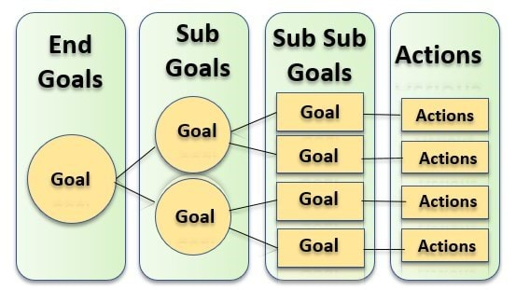
The following image shows how the target goal is divided into sub-goals, that are then linked with executable actions.

Slide 16
Operator Sub goaling
In the MEA process, we detect the differences between the current state and goal state. Once these differences occur, then we can apply an operator to reduce the differences.
But sometimes it is possible that an operator cannot be applied to the current state. So we create the sub problem of the current state, in which operator can be applied, such type of backward chaining in which operators are selected, and then sub goals are set up to establish the preconditions of the operator is called Operator Sub goaling

Slide 17
Algorithm for Means-Ends Analysis
Step 1: Compare CURRENT to GOAL, if there are no differences between both then return Success and Exit.
Step 2: Else, select the most significant difference and reduce it by doing the following steps until the success or
failure occurs.
Select a new operator O which is applicable for the current difference, and if there is no such operator, then signal failure.
Attempt to apply operator O to CURRENT. Make a description of two states.
i) O-Start, a state in which O?s preconditions are satisfied.
ii) O-Result, the state that would result if O were applied In O-start.
If
(First-Part <------ MEA (CURRENT, O-START)
And
(LAST-Part <----- MEA (O-Result, GOAL), are successful, then signal Success and return the result of
combining FIRST-PART, O, and LAST-PART

Slide 18
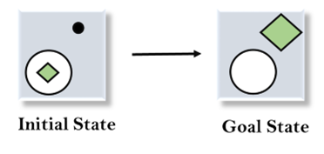
Example of Mean-Ends Analysis
Let's take an example where we know the initial state and goal state as given below. In this problem, we need to get the goal state by finding differences between the initial state and goal state and applying operators.
To solve the above problem, we will first find the differences between initial states and goal states, and for each difference, we will generate a new state and will apply the operators. The operators we have for this problem are:
Move
Delete
Expand

Slide 19

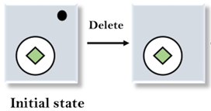
1. Evaluating the initial state: In the first step, we will evaluate the initial state and will compare the initial and Goal state to find the differences between both states.
2. Applying Delete operator: As we can check the first difference is that in goal state there is no dot symbol which is present in the initial state, so, first we will apply the Delete operator to remove this dot.

Slide 20
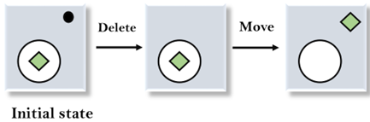
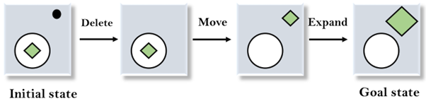
3. Applying Move Operator: After applying the Delete operator, the new state occurs which we will again compare with goal state. After comparing these states, there is another difference that is the square is outside the circle, so, we will apply the Move Operator.
4. Applying Expand Operator: Now a new state is generated in the third step, and we will compare this state with the goal state. After comparing the states there is still one difference which is the size of the square, so, we will apply Expand operator, and finally, it will generate the goal state.

